Slide 1
CS4473/5473: Parallel, Distributed, and Network Programming (PDN)
Dr. Richard Veras
SIMD (AVX) and ILP
STUDENT_NAME

Slide 2
PG Instructions
This assignment has two parts. First, you will work through, describe and analyze a variety of short vector instructions (Single Instruction Multiple Data [SIMD]). Second, you will use these instructions to implement a variety of higher-level functions and analyze those code sequences.
Examples of SIMD and analyzing their behavior. You will run the code in "./0_examples" and work through the "STUDENT_TODOs".
For each example Analyze the osaca report for each example. note you will run 'make measure-osaca' to get the report. For each code block that you analyze you will uncomment the instrumentation marks ({begin,end}_instrumentation) for the block in question and comment out all other marks.
For this pg assignment you will ("./2_assignment"):
Diagram your sequence of SIMD instructions before coding them (this will save you many hours of coding if you do this first)
Additionally, you will include a screenshot of the OSACA analysis for the scalar (reference) code and your vectorized (student todo) code. Fill out the template questions and make a note of your observations.
You are encouraged to use this template, but you are welcome to use your own tool of choice (even pen and paper) to illustrate the examples.
Feel free to resize these slides: https://support.microsoft.com/en-us/office/change-the-size-of-your-slides-040a811c-be43-40b9-8d04-0de5ed79987e

Slide 3
PG Notes
NOTE: You can use any instructions from:
https://software.intel.com/sites/landingpage/IntrinsicsGuide/#techs=SSE4_1,AVX,AVX2
But, I strongly suggest the following instructions:
__m256 _mm256_loadu_ps (float const * mem_addr) // Load
void _mm256_storeu_ps (float * mem_addr, __m256 a) // Store
__m256 _mm256_set1_ps (float a) // set
__m128 _mm256_extractf128_ps (__m256 a, const int imm8) // extract
int _mm_extract_ps (__m128 a, const int imm8) // SSE 4.1
__m256 _mm256_permute_ps (__m256 a, int imm8) // w/in lane // permute with one input
__m256 _mm256_permutevar8x32_ps (__m256 a, __m256i idx) // across lane
__m256 _mm256_blend_ps (__m256 a, __m256 b, const int imm8) // Blend
__m256 _mm256_shuffle_ps (__m256 a, __m256 b, const int imm8) // Shuffle with two inputs
__m256 _mm256_fmadd_ps (__m256 a, __m256 b, __m256 c) // Math

Slide 4
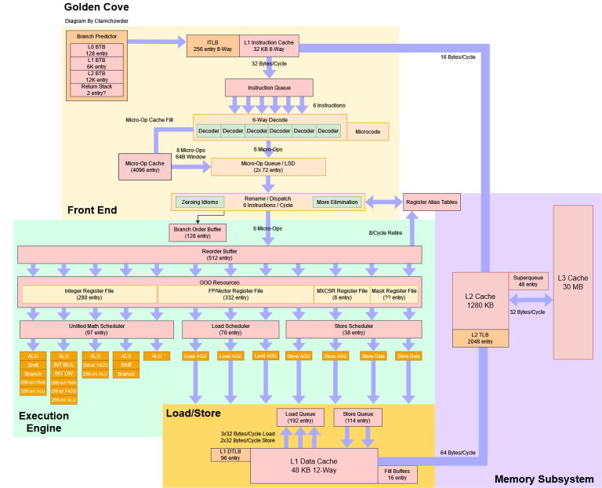
Context: Measuring ILP with OSACA
Modern CPU microarchitectures are really complex (see https://chipsandcheese.com/p/popping-the-hood-on-golden-cove). The process is as follows for each clock cycle
[Front end] Several instructions are fetched from memory.
[Front end] Those instructions are decoded into microoperations.
[Execution Engine] Those microoperations are queued in a buffer.
[EE] When those microoperations have their dependencies resolved and a resource (port) is available they are dispatched to that resource (port).
[EE] if a microoperation is completed on a port (these are pipelined so we will have multiple microops in flight) then its result is either written to a register or sent to the Load/Store Engine.
A lot of this complexity exists to exploit as much instruction level parallelism out of the code as possible. However, we have to extract that parallelism

Slide 5
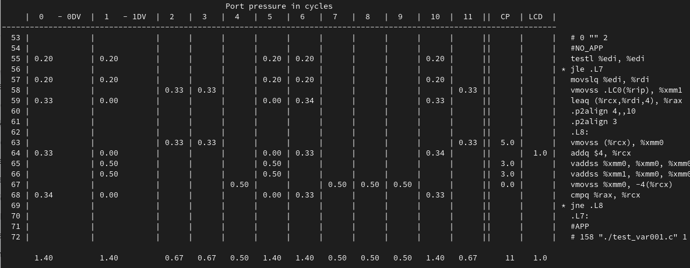
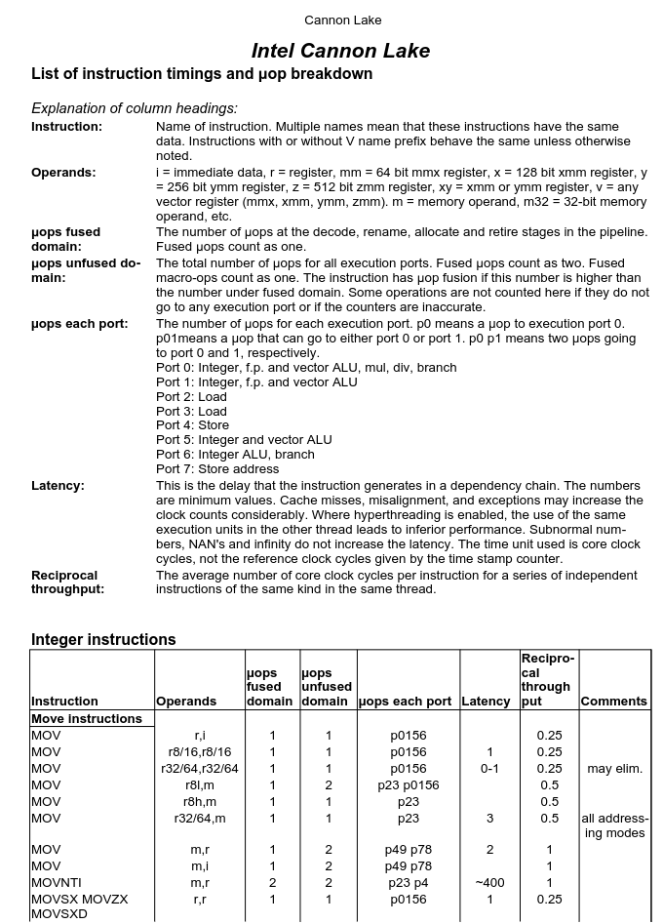
Context: Measuring ILP with OSACA
OSACA is mirroring the microarchitecture (CPU) and simulating the execution of the code. We can do this by hand, we just need to know:
Which port each instruction can go to (resources and reciprocal throughput).
How long each instruction takes (latency).
The Agner Fog Instruction Tables list this:
https://www.agner.org/optimize/instruction_tables.pdf

Slide 6
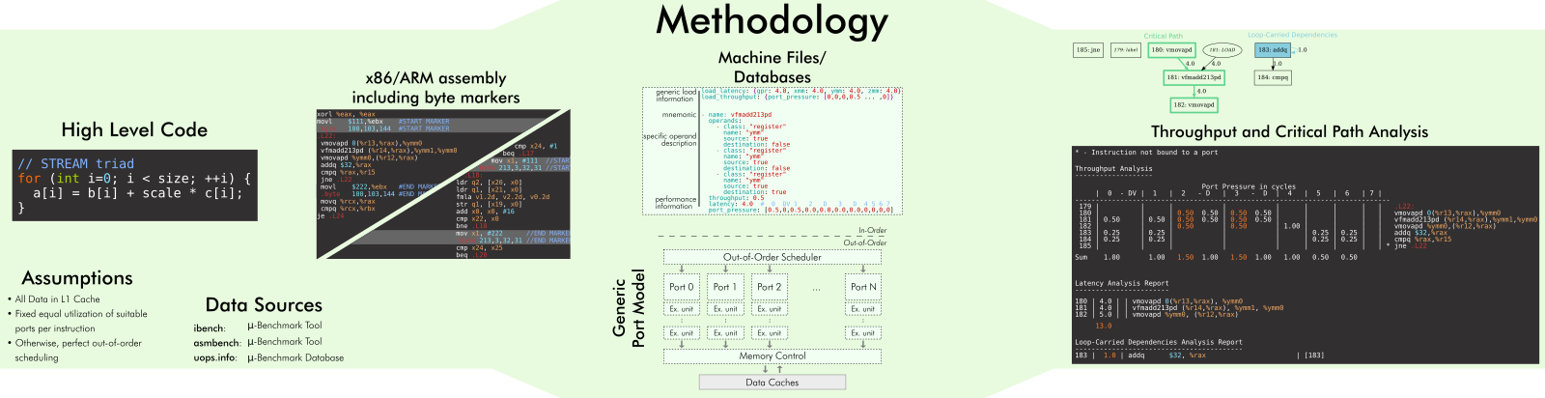
OSACA
OSACA is a cycle accurate simulator for estimating the performance of looped code. (https://github.com/RRZE-HPC/OSACA).
We will use this tool to develop a deeper understand of Instruction Level Parallelism (ILP) while we exploit SIMD parallelism.
Prior to tools like OSACA one would estimate loop throughput using instruction tables (https://www.agner.org/optimize/instruction_tables.pdf )

Slide 7
Problems

Slide 8
./0_example
Run 'make' to see all the STUDENT_TODOs
Run 'make test' to run the verifier. For each problem:
Diagram the SIMD sequence that transforms the input to the desired output.
Implement the student variant of the code to match the reference using only SIMD instructions.
Run 'make measure-osaca' to simulate the performance of the instruction sequences.
For both implementations take a screenshot of the report and fill out the template questions.

Slide 9
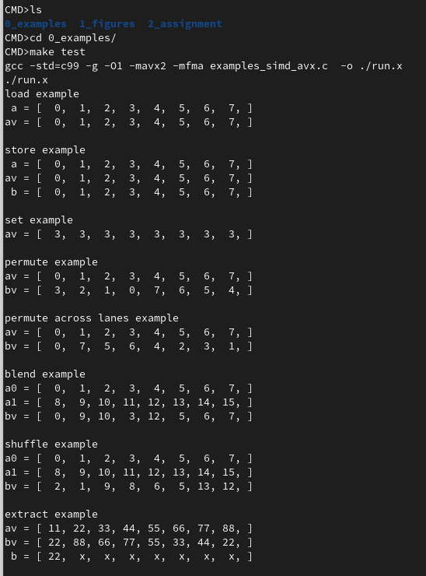
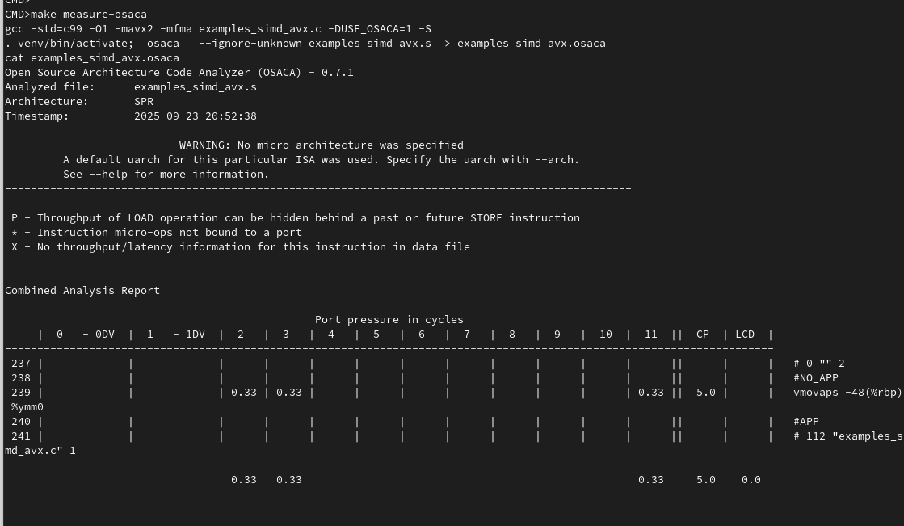
./0_example

Slide 10
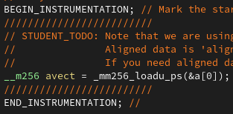
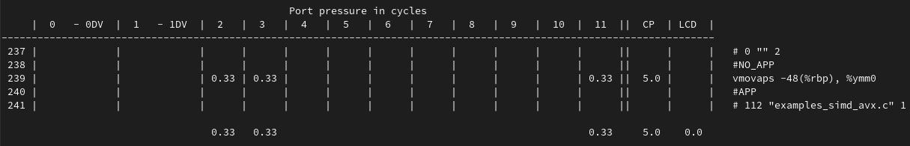
Load example: OSACA
Instrumented Reference Code
_mm256_loadu_ps copies 8 floats from memory into a vector
The iteration is translated into 1 assembly instruction "vmovaps mem, reg"
The latency (critical path [CP]) is 5 cycles.
There are no (0.0) Loop Caried Dependencies (LCD)
The bottleneck (max cycles) is on ports 2,3 and 11 for 0.33 cycles
An iteration of this loop will complete every .33 cycles (max of LCD and bottleneck).
In a loop this processor can complete 1/0.33= 3 loads every cycle.
OSACA Report

Slide 11
Store example: OSACA
Look up the instruction https://www.intel.com/content/www/us/en/docs/intrinsics-guide/index.html# what is it?
What assembly instruction(s) does it translate to?
What is the latency of this instruction? How long does it take to complete.
Were there any loop carried dependencies reported? (for these examples it should not matter)
What ports execute this instruction?
What is the throughput of this instruction? (max of LCD and bottleneck)
How many of these instructions can this CPU execute? Osaca defaults to intel skylake (https://chipsandcheese.com/p/skylake-intels-longest-serving-architecture )
Instrumented Reference Code
ADD SNIPPET
OSACA Report
ADD OSACA Report

Slide 12
Set example: OSACA
Look up the instruction https://www.intel.com/content/www/us/en/docs/intrinsics-guide/index.html# what is it?
What assembly instruction(s) does it translate to?
What is the latency of this instruction? How long does it take to complete.
Were there any loop carried dependencies reported? (for these examples it should not matter)
What ports execute this instruction?
What is the throughput of this instruction? (max of LCD and bottleneck)
How many of these instructions can this CPU execute? Osaca defaults to intel skylake (https://chipsandcheese.com/p/skylake-intels-longest-serving-architecture )
Instrumented Reference Code
ADD SNIPPET
OSACA Report
ADD OSACA Report

Slide 13
Permute example: OSACA
Look up the instruction https://www.intel.com/content/www/us/en/docs/intrinsics-guide/index.html# what is it?
What assembly instruction(s) does it translate to?
What is the latency of this instruction? How long does it take to complete.
Were there any loop carried dependencies reported? (for these examples it should not matter)
What ports execute this instruction?
What is the throughput of this instruction? (max of LCD and bottleneck)
How many of these instructions can this CPU execute? Osaca defaults to intel skylake (https://chipsandcheese.com/p/skylake-intels-longest-serving-architecture )
Instrumented Reference Code
ADD SNIPPET
OSACA Report
ADD OSACA Report

Slide 14
Permute across lanes example: OSACA
Look up the instruction https://www.intel.com/content/www/us/en/docs/intrinsics-guide/index.html# what is it?
What assembly instruction(s) does it translate to?
What is the latency of this instruction? How long does it take to complete.
Were there any loop carried dependencies reported? (for these examples it should not matter)
What ports execute this instruction?
What is the throughput of this instruction? (max of LCD and bottleneck)
How many of these instructions can this CPU execute? Osaca defaults to intel skylake (https://chipsandcheese.com/p/skylake-intels-longest-serving-architecture )
Instrumented Reference Code
ADD SNIPPET
OSACA Report
ADD OSACA Report

Slide 15
Blend example: OSACA
Look up the instruction https://www.intel.com/content/www/us/en/docs/intrinsics-guide/index.html# what is it?
What assembly instruction(s) does it translate to?
What is the latency of this instruction? How long does it take to complete.
Were there any loop carried dependencies reported? (for these examples it should not matter)
What ports execute this instruction?
What is the throughput of this instruction? (max of LCD and bottleneck)
How many of these instructions can this CPU execute? Osaca defaults to intel skylake (https://chipsandcheese.com/p/skylake-intels-longest-serving-architecture )
Instrumented Reference Code
ADD SNIPPET
OSACA Report
ADD OSACA Report

Slide 16
Shuffle example: OSACA
Look up the instruction https://www.intel.com/content/www/us/en/docs/intrinsics-guide/index.html# what is it?
What assembly instruction(s) does it translate to?
What is the latency of this instruction? How long does it take to complete.
Were there any loop carried dependencies reported? (for these examples it should not matter)
What ports execute this instruction?
What is the throughput of this instruction? (max of LCD and bottleneck)
How many of these instructions can this CPU execute? Osaca defaults to intel skylake (https://chipsandcheese.com/p/skylake-intels-longest-serving-architecture )
Instrumented Reference Code
ADD SNIPPET
OSACA Report
ADD OSACA Report

Slide 17
Extract example: OSACA
Look up the instruction https://www.intel.com/content/www/us/en/docs/intrinsics-guide/index.html# what is it?
What assembly instruction(s) does it translate to?
What is the latency of this instruction? How long does it take to complete.
Were there any loop carried dependencies reported? (for these examples it should not matter)
What ports execute this instruction?
What is the throughput of this instruction? (max of LCD and bottleneck)
How many of these instructions can this CPU execute? Osaca defaults to intel skylake (https://chipsandcheese.com/p/skylake-intels-longest-serving-architecture )
Instrumented Reference Code
ADD SNIPPET
OSACA Report
ADD OSACA Report

Slide 18
./2_assignment
Run 'make' to see all the STUDENT_TODOs
Run 'make test' to run the verifier. For each problem:
Diagram the SIMD sequence that transforms the input to the desired output.
Implement the student variant of the code to match the reference using only SIMD instructions.
Run 'make measure-osaca' to simulate the code performance for the reference and your implementation.
For both implementations take a screenshot of the report and fill out the template questions.

Slide 19
01: test_reverse_8xfloat
v
0
1
2
3
4
5
6
7
v
0
1
2
3
4
5
6
7
Input (a)
STUDENT_TODO:
What sequence of SIMD (AVX) instructions results in this output?
Use figures – not code -- to describe the sequence.
https://www.intel.com/content/www/us/en/docs/intrinsics-guide/index.html
Output (b)
0
0
1
1
2
2
3
3
4
4
5
5
6
6
7
7

Slide 20
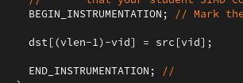
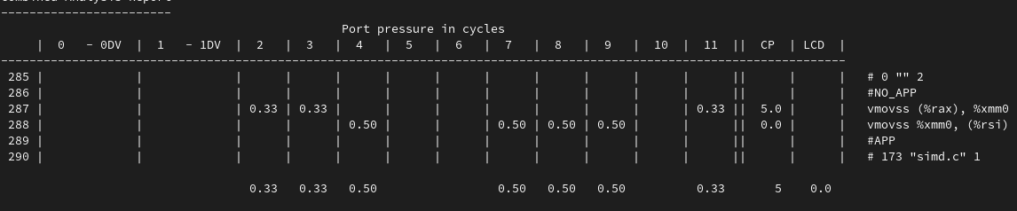
01: test_reverse_8xfloat: OSACA reference
Instrumented Reference Code
Each iteration copies one element of src to its reversed location in dst.
The iteration is translated into 2 assembly instructions (vmovss) for loading and storing.
The critical path, or time it takes a specific iteration to complete, is 5 cycles.
There are no (0.0) Loop Caried Dependencies (LCD)
The bottleneck (max cycles) is on ports 4,7,8 and 9 for 0.5 cycles
An iteration of this loop will complete every .5 cycles (max of LCD and bottleneck).
Or, this loop can complete 1/0.5= 2 iterations of 'reverse' every cycle.
OSACA Report

Slide 21
01: test_reverse_8xfloat: OSACA student
Instrumented Student Code
What 'work' does each iteration (Code between the markers) do?
What did the code get translated to?
How many cycles does the longest instruction path take (critical path)?
If there is a Loop Carried Dependency (LCD) how long does it take?
Which instruction ports (functional units) have the highest bottleneck?
This is a pipelined processor. How many cycles elapse between the completion of successive iterations?
How much 'work' is completed per cycle?
ADD SNIPPET
OSACA Report
ADD OSACA Report

Slide 22
02: test_rotate_by_4_8xfloat:
v
0
1
2
3
4
5
6
7
v
0
1
2
3
4
5
6
7
Input (a)
STUDENT_TODO:
What sequence of SIMD (AVX) instructions results in this output?
Use figures – not code -- to describe the sequence.
https://www.intel.com/content/www/us/en/docs/intrinsics-guide/index.html
Output (b)
0
1
2
3
4
5
6
7

Slide 23
02: test_rotate_by_4_8xfloat: OSACA reference
Instrumented Reference Code
What 'work' does each iteration (Code between the markers) do?
What did the code get translated to?
How many cycles does the longest instruction path take (critical path)?
If there is a Loop Carried Dependency (LCD) how long does it take?
Which instruction ports (functional units) have the highest bottleneck?
This is a pipelined processor. How many cycles elapse between the completion of successive iterations?
How much 'work' is completed per cycle?
ADD SNIPPET
OSACA Report
ADD OSACA Report

Slide 24
02: test_rotate_by_4_8xfloat: OSACA student
Instrumented Student Code
What 'work' does each iteration (Code between the markers) do?
What did the code get translated to?
How many cycles does the longest instruction path take (critical path)?
If there is a Loop Carried Dependency (LCD) how long does it take?
Which instruction ports (functional units) have the highest bottleneck?
This is a pipelined processor. How many cycles elapse between the completion of successive iterations?
How much 'work' is completed per cycle?
ADD SNIPPET
OSACA Report
ADD OSACA Report

Slide 25
03: test_rotate_by_2_8xfloat:
v
0
1
2
3
4
5
6
7
v
0
1
2
3
4
5
6
7
Input (a)
STUDENT_TODO:
What sequence of SIMD (AVX) instructions results in this output?
Use figures – not code -- to describe the sequence.
https://www.intel.com/content/www/us/en/docs/intrinsics-guide/index.html
Output (b)
0
1
2
3
4
5
6
7

Slide 26
03: test_rotate_by_2_8xfloat: OSACA reference
Instrumented Reference Code
What 'work' does each iteration (Code between the markers) do?
What did the code get translated to?
How many cycles does the longest instruction path take (critical path)?
If there is a Loop Carried Dependency (LCD) how long does it take?
Which instruction ports (functional units) have the highest bottleneck?
This is a pipelined processor. How many cycles elapse between the completion of successive iterations?
How much 'work' is completed per cycle?
ADD SNIPPET
OSACA Report
ADD OSACA Report

Slide 27
03: test_rotate_by_2_8xfloat: OSACA student
Instrumented Student Code
What 'work' does each iteration (Code between the markers) do?
What did the code get translated to?
How many cycles does the longest instruction path take (critical path)?
If there is a Loop Carried Dependency (LCD) how long does it take?
Which instruction ports (functional units) have the highest bottleneck?
This is a pipelined processor. How many cycles elapse between the completion of successive iterations?
How much 'work' is completed per cycle?
ADD SNIPPET
OSACA Report
ADD OSACA Report

Slide 28
04: test_rotate_by_1_8xfloat
v
0
1
2
3
4
5
6
7
v
0
1
2
3
4
5
6
7
Input (a)
STUDENT_TODO:
What sequence of SIMD (AVX) instructions results in this output?
Use figures – not code -- to describe the sequence.
https://www.intel.com/content/www/us/en/docs/intrinsics-guide/index.html
Output (b)
0
1
2
3
4
5
6
7

Slide 29
04: test_rotate_by_1_8xfloat: OSACA reference
Instrumented Reference Code
What 'work' does each iteration (Code between the markers) do?
What did the code get translated to?
How many cycles does the longest instruction path take (critical path)?
If there is a Loop Carried Dependency (LCD) how long does it take?
Which instruction ports (functional units) have the highest bottleneck?
This is a pipelined processor. How many cycles elapse between the completion of successive iterations?
How much 'work' is completed per cycle?
ADD SNIPPET
OSACA Report
ADD OSACA Report

Slide 30
04: test_rotate_by_1_8xfloat: OSACA student
Instrumented Student Code
What 'work' does each iteration (Code between the markers) do?
What did the code get translated to?
How many cycles does the longest instruction path take (critical path)?
If there is a Loop Carried Dependency (LCD) how long does it take?
Which instruction ports (functional units) have the highest bottleneck?
This is a pipelined processor. How many cycles elapse between the completion of successive iterations?
How much 'work' is completed per cycle?
ADD SNIPPET
OSACA Report
ADD OSACA Report

Slide 31
05: test_transpose_4x2_colmaj_8xfloat
v
0
1
2
3
4
5
6
7
v
0
1
2
3
4
5
6
7
Input (a)
STUDENT_TODO:
What sequence of SIMD (AVX) instructions results in this output?
Use figures – not code -- to describe the sequence.
https://www.intel.com/content/www/us/en/docs/intrinsics-guide/index.html
Output (b)
0
1
2
3
4
5
6
7

Slide 32
05: test_transpose_4x2_colmaj_8xfloat OSACA reference
Instrumented Reference Code
What 'work' does each iteration (Code between the markers) do?
What did the code get translated to?
How many cycles does the longest instruction path take (critical path)?
If there is a Loop Carried Dependency (LCD) how long does it take?
Which instruction ports (functional units) have the highest bottleneck?
This is a pipelined processor. How many cycles elapse between the completion of successive iterations?
How much 'work' is completed per cycle?
ADD SNIPPET
OSACA Report
ADD OSACA Report

Slide 33
05: test_transpose_4x2_colmaj_8xfloat OSACA student
Instrumented Student Code
What 'work' does each iteration (Code between the markers) do?
What did the code get translated to?
How many cycles does the longest instruction path take (critical path)?
If there is a Loop Carried Dependency (LCD) how long does it take?
Which instruction ports (functional units) have the highest bottleneck?
This is a pipelined processor. How many cycles elapse between the completion of successive iterations?
How much 'work' is completed per cycle?
ADD SNIPPET
OSACA Report
ADD OSACA Report

Slide 34
06: test_rotate_by_1_16xfloat
v
0
1
2
3
4
5
6
7
v
0
1
2
3
4
5
6
7
Input
(a[0:8], a[8:16])
Output
(b[0:8],b[8,16])
STUDENT_TODO:
What sequence of SIMD (AVX) instructions results in this output?
Use figures – not code -- to describe the sequence.
https://www.intel.com/content/www/us/en/docs/intrinsics-guide/index.html
0
8
1
9
1
9
2
10
2
10
3
11
3
11
4
12
4
12
5
13
5
13
6
14
6
14
7
15
7
15
8
0

Slide 35
06: test_rotate_by_1_16xfloat: OSACA Ref
Instrumented Reference Code
What 'work' does each iteration (Code between the markers) do?
What did the code get translated to?
How many cycles does the longest instruction path take (critical path)?
If there is a Loop Carried Dependency (LCD) how long does it take?
Which instruction ports (functional units) have the highest bottleneck?
This is a pipelined processor. How many cycles elapse between the completion of successive iterations?
How much 'work' is completed per cycle?
ADD SNIPPET
OSACA Report
ADD OSACA Report

Slide 36
06: test_rotate_by_1_16xfloat: OSACA student
Instrumented Student Code
What 'work' does each iteration (Code between the markers) do?
What did the code get translated to?
How many cycles does the longest instruction path take (critical path)?
If there is a Loop Carried Dependency (LCD) how long does it take?
Which instruction ports (functional units) have the highest bottleneck?
This is a pipelined processor. How many cycles elapse between the completion of successive iterations?
How much 'work' is completed per cycle?
ADD SNIPPET
OSACA Report
ADD OSACA Report

Slide 37
07: test_transpose_4x4_colmaj_8xfloat:
v
0
1
2
3
4
5
6
7
v
0
1
2
3
4
5
6
7
Input
(a[0:8], a[8:16])
Output
(b[0:8],b[8,16])
STUDENT_TODO:
What sequence of SIMD (AVX) instructions results in this output?
Use figures – not code -- to describe the sequence.
https://www.intel.com/content/www/us/en/docs/intrinsics-guide/index.html
0
8
0
2
1
9
4
6
2
10
8
10
3
11
12
14
4
12
1
3
5
13
5
7
6
14
9
11
7
15
13
15

Slide 38
07: test_transpose_4x4_colmaj_8xfloat: OSACA ref
Instrumented Reference Code
What 'work' does each iteration (Code between the markers) do?
What did the code get translated to?
How many cycles does the longest instruction path take (critical path)?
If there is a Loop Carried Dependency (LCD) how long does it take?
Which instruction ports (functional units) have the highest bottleneck?
This is a pipelined processor. How many cycles elapse between the completion of successive iterations?
How much 'work' is completed per cycle?
ADD SNIPPET
OSACA Report
ADD OSACA Report

Slide 39
07: test_transpose_4x4_colmaj_8xfloat: OSACA Student
Instrumented Student Code
What 'work' does each iteration (Code between the markers) do?
What did the code get translated to?
How many cycles does the longest instruction path take (critical path)?
If there is a Loop Carried Dependency (LCD) how long does it take?
Which instruction ports (functional units) have the highest bottleneck?
This is a pipelined processor. How many cycles elapse between the completion of successive iterations?
How much 'work' is completed per cycle?
ADD SNIPPET
OSACA Report
ADD OSACA Report

Slide 40
08: test_transpose_8x4_colmaj_8xfloat:
v
0
1
2
3
4
5
6
7
v
0
1
2
3
4
5
6
7
Input
(a[0:8], a[8:16],a[16:24],a[24:32])
Output
(b[0:8],b[8,16], b[16:24],b[24,32])
STUDENT_TODO:
What sequence of SIMD (AVX) instructions results in this output?
Use figures – not code -- to describe the sequence.
https://www.intel.com/content/www/us/en/docs/intrinsics-guide/index.html
0
8
16
24
6
0
2
4
1
9
17
25
10
12
14
8
2
10
18
26
18
20
22
16
3
11
19
27
26
28
30
24
4
12
20
28
3
5
7
1
5
13
21
29
11
13
15
9
6
14
22
30
19
21
23
17
7
15
23
31
25
27
29
31

Slide 41
08: test_transpose_8x4_colmaj_8xfloat: OSACA ref
Instrumented Reference Code
What 'work' does each iteration (Code between the markers) do?
What did the code get translated to?
How many cycles does the longest instruction path take (critical path)?
If there is a Loop Carried Dependency (LCD) how long does it take?
Which instruction ports (functional units) have the highest bottleneck?
This is a pipelined processor. How many cycles elapse between the completion of successive iterations?
How much 'work' is completed per cycle?
ADD SNIPPET
OSACA Report
ADD OSACA Report

Slide 42
08: test_transpose_8x4_colmaj_8xfloat: OSACA student
Instrumented Student Code
What 'work' does each iteration (Code between the markers) do?
What did the code get translated to?
How many cycles does the longest instruction path take (critical path)?
If there is a Loop Carried Dependency (LCD) how long does it take?
Which instruction ports (functional units) have the highest bottleneck?
This is a pipelined processor. How many cycles elapse between the completion of successive iterations?
How much 'work' is completed per cycle?
ADD SNIPPET
OSACA Report
ADD OSACA Report

Slide 43
09: test_gather_at_stride_8xfloat:
v
0
1
2
3
4
5
6
7
v
0
1
2
3
4
5
6
7
Input
(a[0:8], a[8:16],a[16:24],a[24:32])
Output
(b[0:8]])
STUDENT_TODO:
What sequence of SIMD (AVX) instructions results in this output?
Use figures – not code -- to describe the sequence.
https://www.intel.com/content/www/us/en/docs/intrinsics-guide/index.html
0
8
16
24
0
1
9
17
25
4
2
10
18
26
8
3
11
19
27
12
4
12
20
28
16
5
13
21
29
20
6
14
22
30
24
7
15
23
31
28

Slide 44
09: test_gather_at_stride_8xfloat: OSACA ref
Instrumented Reference Code
What 'work' does each iteration (Code between the markers) do?
What did the code get translated to?
How many cycles does the longest instruction path take (critical path)?
If there is a Loop Carried Dependency (LCD) how long does it take?
Which instruction ports (functional units) have the highest bottleneck?
This is a pipelined processor. How many cycles elapse between the completion of successive iterations?
How much 'work' is completed per cycle?
ADD SNIPPET
OSACA Report
ADD OSACA Report

Slide 45
09: test_gather_at_stride_8xfloat: OSACA student
Instrumented Student Code
What 'work' does each iteration (Code between the markers) do?
What did the code get translated to?
How many cycles does the longest instruction path take (critical path)?
If there is a Loop Carried Dependency (LCD) how long does it take?
Which instruction ports (functional units) have the highest bottleneck?
This is a pipelined processor. How many cycles elapse between the completion of successive iterations?
How much 'work' is completed per cycle?
ADD SNIPPET
OSACA Report
ADD OSACA Report

Slide 46
10: test_scatter_at_stride_8xfloat:
v
0
1
2
3
4
5
6
7
Input
(a[0:8])
v
0
1
2
3
4
5
6
7
Output
(b[0:8],b[8,16], b[16:24],b[24,32])
STUDENT_TODO:
What sequence of SIMD (AVX) instructions results in this output?
Use figures – not code -- to describe the sequence.
https://www.intel.com/content/www/us/en/docs/intrinsics-guide/index.html
0
0
2
4
6
1
x
x
x
x
2
x
x
x
x
3
x
x
x
x
4
1
3
5
7
5
x
x
x
x
6
x
x
x
x
7
x
x
x
x

Slide 47
10: test_scatter_at_stride_8xfloat: OSACA ref
Instrumented Reference Code
What 'work' does each iteration (Code between the markers) do?
What did the code get translated to?
How many cycles does the longest instruction path take (critical path)?
If there is a Loop Carried Dependency (LCD) how long does it take?
Which instruction ports (functional units) have the highest bottleneck?
This is a pipelined processor. How many cycles elapse between the completion of successive iterations?
How much 'work' is completed per cycle?
ADD SNIPPET
OSACA Report
ADD OSACA Report

Slide 48
10: test_scatter_at_stride_8xfloat: OSACA student
Instrumented Student Code
What 'work' does each iteration (Code between the markers) do?
What did the code get translated to?
How many cycles does the longest instruction path take (critical path)?
If there is a Loop Carried Dependency (LCD) how long does it take?
Which instruction ports (functional units) have the highest bottleneck?
This is a pipelined processor. How many cycles elapse between the completion of successive iterations?
How much 'work' is completed per cycle?
ADD SNIPPET
OSACA Report
ADD OSACA Report

Slide 49
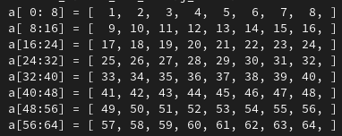
11: test_matvec_8x8_colmaj_8xfloat:
Input
Output
STUDENT_TODO:
What sequence of SIMD (AVX) instructions results in this output?
Use figures – not code -- to describe the sequence.
https://www.intel.com/content/www/us/en/docs/intrinsics-guide/index.html

Slide 50
11: test_matvec_8x8_colmaj_8xfloat: OSACA ref
Instrumented Reference Code
What 'work' does each iteration (Code between the markers) do?
What did the code get translated to?
How many cycles does the longest instruction path take (critical path)?
If there is a Loop Carried Dependency (LCD) how long does it take?
Which instruction ports (functional units) have the highest bottleneck?
This is a pipelined processor. How many cycles elapse between the completion of successive iterations?
How much 'work' is completed per cycle?
ADD SNIPPET
OSACA Report
ADD OSACA Report

Slide 51
11: test_matvec_8x8_colmaj_8xfloat: OSACA student
Instrumented Student Code
What 'work' does each iteration (Code between the markers) do?
What did the code get translated to?
How many cycles does the longest instruction path take (critical path)?
If there is a Loop Carried Dependency (LCD) how long does it take?
Which instruction ports (functional units) have the highest bottleneck?
This is a pipelined processor. How many cycles elapse between the completion of successive iterations?
How much 'work' is completed per cycle?
ADD SNIPPET
OSACA Report
ADD OSACA Report

Slide 52
Assets
Feel free to modify and use these.

Slide 53
Use these vectors as shapes for your diagrams
0
8
16
24
32
40
48
56
1
9
17
25
33
41
49
57
2
10
18
26
34
42
50
58
3
11
19
27
35
43
51
59
4
12
20
28
36
44
52
60
5
13
21
29
37
45
53
61
6
14
22
30
38
46
54
62
7
15
23
31
39
47
55
63

Slide 54








Or these vectors as pictures (you can scale these)

Slide 55
Load
Memory:
buff[]
Vector Register:
vect
0
1
2
3
4
5
6
7
.
.
a
a
__m256 vect = _mm256_load_ps(&buff[0]);
b
b
c
c
d
d
e
e
f
f
g
g
h
h

Slide 56
Store
Vector Register:
vect
Memory:
buff[]
a
0
1
2
3
4
5
6
7
.
.
a
_mm256_store_ps(&buff[0],vect );
b
b
c
c
d
d
e
e
f
f
g
g
h
h

Slide 57
Set1
Vector Register:
vect
a
__m256 vect = _mm256_set1_ps(a);
a
constant
a
a
a
a
a
a
a

Slide 58
Permute Across Lanes Example
Vector Register:
index avect
Vector Register:
bvect
5
a
f
__m256i index = _mm256_set_epi32(1,3,2,4,7,0,6,5);
__m256 bvect = _mm256_permutevar8x32_ps(avect,index);
6
b
g
0
c
a
7
d
h
4
e
e
2
f
c
3
g
d
1
h
b

Slide 59
Shuffle
Vector Register:
avect bvect
Vector Register:
cvect
a
i
c
int imm = 0b01001110;
__m256 cvect = _mm256_shuffle_ps(avect,bvect,imm);
b
j
d
c
k
i
DEFINE SELECT4(src, control) { CASE(control[1:0]) OF
0: tmp[31:0] := src[31:0]
1: tmp[31:0] := src[63:32]
2: tmp[31:0] := src[95:64]
3: tmp[31:0] := src[127:96]
ESAC RETURN tmp[31:0] }
dst[31:0] := SELECT4(a[127:0], imm8[1:0]) dst[63:32] := SELECT4(a[127:0], imm8[3:2]) dst[95:64] := SELECT4(b[127:0], imm8[5:4]) dst[127:96] := SELECT4(b[127:0], imm8[7:6]) dst[159:128] := SELECT4(a[255:128], imm8[1:0]) dst[191:160] := SELECT4(a[255:128], imm8[3:2]) dst[223:192] := SELECT4(b[255:128], imm8[5:4]) dst[255:224] := SELECT4(b[255:128], imm8[7:6]) dst[MAX:256] := 0
d
l
j
e
m
g
f
n
h
g
o
m
h
p
n

Slide 60
Extract
Vector Register:
vect
Memory:
buff[]
a
0
1
2
3
4
5
6
7
.
.
a
buff[0] = _mm256_cvtss_f32(vect);
b
c
d
e
f
g
h

Slide 61
Blend
Vector Register:
avect bvect
Vector Register:
cvect
a
i
a
int imm = 0b01001110;
__m256 cvect = _mm256_blend_ps(avect,bvect,imm);
b
j
j
c
k
k
FOR j := 0 to 7
i := j*32
IF imm8[j]
dst[i+31:i] := b[i+31:i]
ELSE
dst[i+31:i] := a[i+31:i]
FI
ENDFOR
d
l
l
e
m
e
f
n
f
g
o
o
h
p
h

Slide 62
Fused Multiply and Add (FMADD)
Vector Register:
avect bvect cvect
Vector Register:
dvect
a0
b0
c0
a0*b0+c0
a1
b1
c1
a1*b1+c1
a2
b2
c2
a2*b2+c2
a3
b3
c3
a3*b3+c3
a4
b4
c4
a4*b4+c4
a5
b5
c5
a5*b5+c5
a6
b6
c6
a6*b6+c6
a7
b7
c7
a7*b7+c7
__m256 dvect = _mm256_fmadd_ps(avect,bvect,cvect );

Slide 63
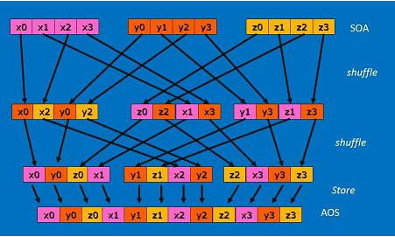
SIMD Vectorization
https://software.intel.com/content/www/us/en/develop/articles/3d-vector-normalization-using-256-bit-intel-advanced-vector-extensions-intel-avx.html
SEE: https://www.cs.virginia.edu/~cr4bd/3330/F2018/simdref.html

